Slide 1


Allianz Trade Global Survey
Ana Boata, Head of Economic Research
Ano Kuhanathan, Head of Corporate Research
Françoise Huang, Senior Economist for APAC & Trade
Paris
April 12th, 2022
Allianz Trade is the trademark used to designate a range of services provided by Euler Hermes.

Slide 2
Troubled trade:
How will exporters adapt in 2022?

Slide 3
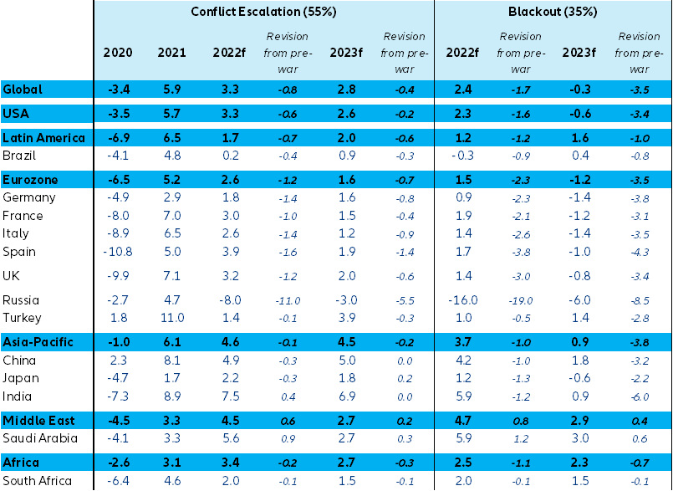
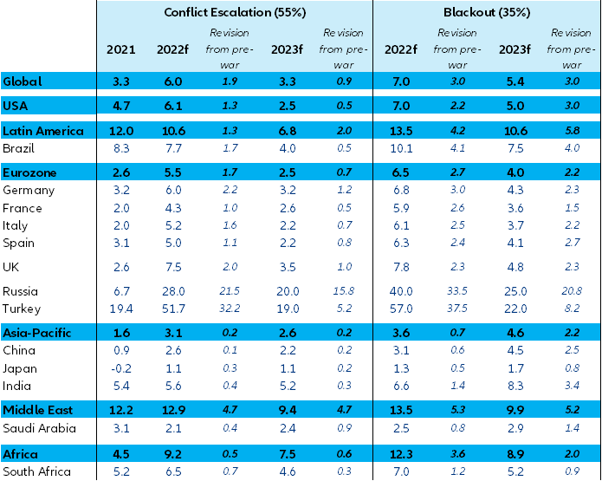
Global economy: Slowflation vs. Stagflation
GDP growth forecasts
Inflation forecasts
  Source: Allianz Research
  Source: Allianz Research

Slide 4
Increased pessimism among exporters
Allianz Trade Global Survey
Turnover expectations
Breakdown of 2022 trade growth forecast revisions (pp)
Sources: Allianz Research
Source: Allianz Research
Since the war, pessimism has increased with 22% of corporates expecting export turnover to decrease in 2022 against 6% pre-war. French and Italian exporters are most pessimistic with 29% and 23% of them expecting a decrease in the export turnover (against 3% pre-war)
Higher oil prices, the confidence and demand shock and extended supply-chain bottlenecks lead to sizeable revisions in global trade forecasts. We now expect global trade to grow in 2022 by +4.0% in volume terms (vs. +6.0% previously) and +10.9% in value terms (vs. +7.2% previously).

Slide 5
Multiple risks on the rise since the war
How do you expect the following challenges to evolve in 2022 in relation to exporting?
(share of exporters considering the risks to “become more of a challenge“)
Pre-war
After invasion of Ukraine
26%
42%
Sources: Allianz Research
Top 5 risks for 2022 for European exporters: energy (57%), geopolitical tensions (50%), increased transportation bottlenecks (49%), input costs and shortages (46%) and high funding costs (43%)
The top 3 risk for French exporters is the cost or availability of inputs while French exporters are more worried about cyber attacks than higher funding costs or social unrest. Italian exporters are generally more worried.

Slide 6
More than one third expect a significant profitability impact from higher energy prices
Allianz Trade Global Survey
How do you expect energy prices to evolve in 2022 ?
Brent and TTF Gas
Sources: Allianz Research
Sources: Allianz Research
Corporates in the UK and Italy are most worried about the impact of higher energy prices on profitability while a majority of French corporates expect a moderate impact
We expect oil prices to average 101 USD/bbl this year, but they could peak to over 150 USD/bbl in an adverse scenario.

Slide 7
How much of the rise in commodity prices can corporates take over?
Global Energy shock
Energy and non-energy materials bill increase that could wipe-out all profits
Latest Oil price
Latest Copper price
Latest Wheat price
Latest EUR Electricity price
NB: we only take into account sectors in which energy costs >5% opex
EMU6 = Germany, France, Italy, Spain, Netherlands, Belgium
Sources: Refinitiv, Allianz Research
NB: we only take into account sectors in which non-energy materials costs >5% opex
EMU6 = Germany, France, Italy, Spain, Netherlands, Belgium
Sources: Refinitiv, Allianz Research

Slide 8
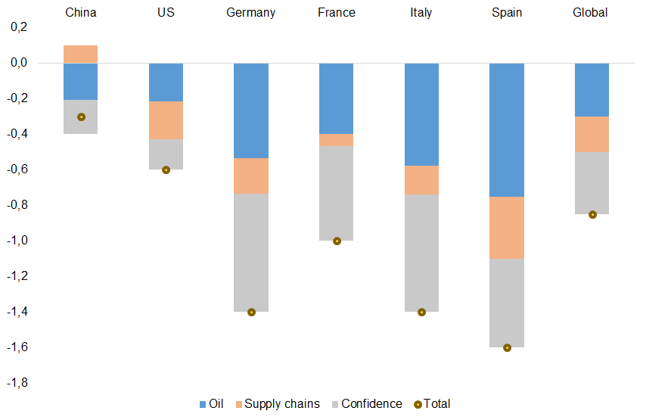
Top #2 risk: Geopolitical tensions
Allianz Trade Global Survey
Breakdown of 2022 GDP growth forecasts revisions (pp)
VIX and Geopolitical Risk index
  Note: the supply-chains factor includes impacts from both the Russia-Ukraine crisis, and the Covid-19 outbreaks in China.
  Source: Allianz Research
Sources: GPR Index, Refinitiv, Allianz Research
*Geopolitical Risk Index:, Federal Reserve
The rapid increase in geopolitical tensions led to an equity market risk repricing pushing the VIX to values above 30pts.
Two thirds of the global growth revision is driven by confidence and supply chain shocks

Slide 9
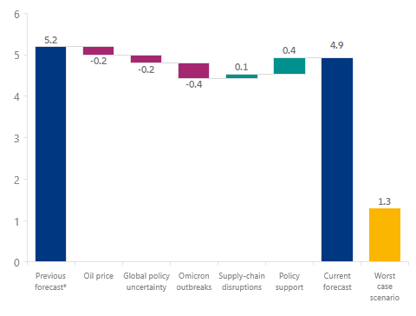
Omicron poses demand and logistics risks
China outlook
2022 GDP growth forecast (%)
Total volume of container vessels anchored outside Chinese ports (TEU)
* Before Ukraine war and Omicron outbreaks in China
Sources: Allianz Research
Sources: Refinitiv, Allianz Research
Assuming that mobility at the national level comes back in May 2022 to a range more in line with non-pandemic conditions, we find that Omicron outbreaks year-to-date will have cost 0.4pp of GDP growth in 2022. In our central scenario, we expect China GDP to grow by +4.9% in 2022. A repeat of 2020 would be the worst case.
Covid-19 outbreaks are likely to lead to prolonged global supply-chain bottlenecks. The volume of container vessels anchored outside Chinese ports has been above-normal in March and April 2022, with the monthly average surplus amounting to 2.2% of annual throughput.
Notes:
, compared with a monthly average of 3.7% in H2 2021

Slide 10
Top #3 risk: Transportation bottlenecks
Allianz Trade Global Survey
China port congestion and global delivery times
Oil prices (USD/bbl) and container freight prices (USD/FEU)
Sources: UNCTAD AIS database, IHS Markit, Allianz Research
Sources: Bloomberg, Refinitiv, Allianz Research
The invasion of Ukraine is leading to bottlenecks in supply-chains at the (European) regional level, while Covid-19 outbreaks in China could have broader global repercussions. Suppliers’ delivery times should remain relatively elevated for longer, but below the 2021 peaks.
Brent and container freight prices have exhibited a 90% correlation since 2020, suggesting a record-high peak of USD14,000/FEU for freight rates in Q2 (+40% from previous peak).

Slide 11
Top #4 risk: Shortages or high input costs
Allianz Trade Global Survey
Share of corporates considering shortage or costs of inputs to become more of a challenge in 2022
Proxy for demand-inventories mismatch
Sources: Allianz Research
Sources: Markit, Allianz Research
51% of corporates in Italy think shortages or high cost of inputs will become more of a challenge in the coming months (compared to 24% pre-war), 47% in the UK and Germany (compared to 32% and 25% respectively) and 38% in France (compared to 26% pre-war). Corporates in household equipment, oil and gas, machinery and equipment, chemicals and ITC are most worried
Production shortfalls and depleting inventories hint towards a risk of a double-dip in global trade in H1 2022

Slide 12
Top #5 risk: Higher funding costs
Allianz Trade Global Survey
Share of corporates considering higher funding costs become more of a challenge in 2022
Total non-financial corporates deposits
(vs. pre-Covid, EURbn)
Sources: Allianz Research
Sources: Allianz Research
Expectations on faster normalization of monetary policy led corporates to expect a rise in funding costs with 42% of them expecting higher funding costs to be a challenge in 2022. The UK and Italian corporates are most worried
French corporates held EUR206bn in excess cash post Covid-19, the highest level among largest EU peers

Slide 13
Non-payment risk on the rise
Allianz Trade Global Survey
Expectations on payment times in the next 6 to 12 months
Expectations on defaults in the next 6 to 12 months
Sources: Allianz Research
Sources: Allianz Research
The strongest upside revision of payment terms has been for German exporters (+33pp to 66%) and UK ones (+25pp to 47%) compared to +9pp for Italian exporters and stability for the French ones
Expectations in rising insolvencies have been most revised on the upside by German and UK exporters +28pp to 58% and +26pp to 53% respectively compared to +23pp for the French ones and +20pp for Italy .

Slide 14
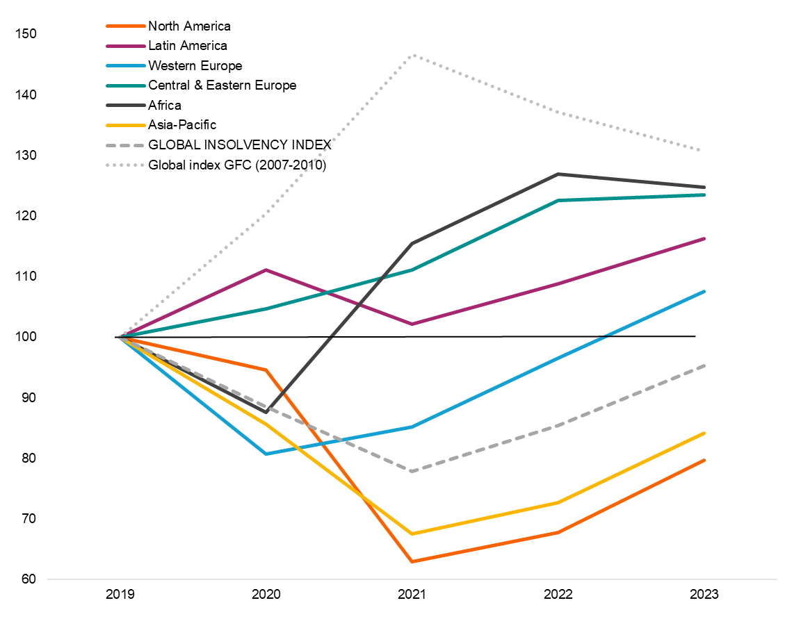
Global insolvencies, the East/West divide
Global and regional insolvency indices*,
level basis 100 in 2019 (left) and annual change in % (right)
  Source: Allianz Research. Notes: Indices are the weighted sum of national indices, each country being weighted by the share of its GDP within the countries used in the sample. Forecasts as of March 23, without additional support measures and with Russian index stabilised at 2021 level.
Low level of insolvencies (-12% in 2021 at the global level). Global insolvencies expected to rise by +10% in 2022 but to remain -5% below pre-Covid levels end-2023. Adverse scenario to add potentially +5/10pp (2022) and +15/25pp (2023) at a global level.

Slide 15
Business strategies in a black-out scenario
Adapting business strategies in the event of intensifying or total trade embargos between Russia and Europe
Share of respondents seeing government financing support as helpful for exports
Sources: Allianz Research
Sources: Allianz Research
47% of exporters will look for new energy suppliers (highest share in Italy), 41% for new suppliers for non-energy commodities (highest share in France) and 41% will increase selling prices (highest share in the UK).
The legacy of the Covid-19 era, state support is still viewed as the ultimate lifeline in crisis times, notably by the French exporters
Notes:
51% of UK corporates plan to increase selling prices further to cope with intensifying or total trade embargoes against 41% on average. 47% of them count on finding new energy suppliers with highest share in Italy (56%).
37% of them would focus on export markets outside Europe, mainly in France and 36% of them could adjust production, mainly in Germany. Increase payment terms to suppliers comes next with 31% of them, mainly in Germany and France

Slide 16
Mitigating export risks
In which of the following ways - if any - are you adapting your exporting strategy, due to the military escalation in Ukraine?
In the context of the invasion of Ukraine by Russia, do you plan to seek investment into your business for the purpose of international development?
Sources: Allianz Research
Sources: Allianz Research
The top 3 export strategies to adapt after the Ukraine invasion are targeting new export markets (47%) with German exporters being most numerous in adapting this strategy (56%), finding new suppliers in the same proportion for all exporters in the four surveyed countries (44%) and finding new transportation services providers (38%) with Italian exporters most numerus (41%).
44% of exporters said to seek more investment for international development than planned before the war with 50% for German exporters. Corporates in agri-food, ITC, retail and real estate are more numerous compared to the total average in seeking more investment compared to pre-war

Slide 17
Cash-flow remains top funding source
Which of the following sources of finance do you intend to use most in 2022?
In the context of the invasion of Ukraine by Russia, which of the following types of government support would support?
Sources: Allianz Research
Sources: Allianz Research
Cash flow in the top source of financing for more than half of exporters, followed by bank loans and credit from suppliers. 51% of exporters think financing supports in the forms of state guaranteed loans and direct subsidies would help their business withstand better the impact of the war. This compares to less than 40% pre-war. This is followed by new FTAs (47% and mainly from French and UK corporates) and lower regulation (44% and mainly from UK and Italian corporates).

Slide 18
Export strategy
beyond the war

Slide 19
Digitalization a resilience tool
Allianz Trade Global Survey
Adaptation strategies to Covid-19
Digitalization in times of Covid-19 by country
Sources: Allianz Research
Sources: Allianz Research
Covid-19 was a catalyst for digitalization as it was mentioned as the 2nd adaptation strategy by exporters. 43% of global firms stated they used digitalization to cope with the fallout of covid-19/
A majority of Chinese firms declared that they digitalized their business during Covid-19, while just 36% of French firms or 33% of UK firms stated so.

Slide 20
Digitalization a mean to different ends
Allianz Trade Global Survey
Digitalization engagement
Top reason for digitalization efforts
Sources: Allianz Research
Sources: Allianz Research
Digitalization is a strong trend with almost all respondents stating that their organization engaged in it.
Interestingly, while respondents from most countries use digitalization in a view to increase productivity, Chinese firms aimed at increasing resilience of supply chains and German ones to reduce costs.

Slide 21
ESG adaptation “You go ahead”
Allianz Trade Global Survey
Top 3 ESG adaptation strategy
#1 : Adjusting your relations with your suppliers
#2 : Updating business terms to include ESG elements
#3 : Adjusting how you transport and supply goods
Sources: Allianz Research
ESG adaptation is not yet at the heart of firms concerns and most exporters state that they first adjust their relations with suppliers (before adjusting their own processes). Chinese firms seem to be more concerned by adapting to ESG than their global competitors.

Slide 22
ESG Carbon prices too low for now
Allianz Trade Global Survey
Exporters planning to increase prices due to compensate for carbon taxes
EU Carbon price (EUR/ Mt)
Sources: Allianz Research
Sources: Refinitiv, Allianz Research
We find that only a small share of exporters plan to increase prices to compensate for carbon taxes, although a majority of Chinese firms declare so. This tends to underline that carbon prices are still too low to lead to a major change in global trade practices.

Slide 23
More businesses are bracing for a hit to turnovers in 2022.
In the 1st round of our survey, just 6% of companies were worried about turnover dropping in 2022; now, the share has risen to 22%, mostly in the chemicals, energy & utilities and machinery & equipment sectors.
State support is still viewed as the ultimate lifeline
Covid-19 era, state support is still viewed as the ultimate lifeline in crisis times. High energy prices, geopolitical tensions, increased transportation bottlenecks, sanctions against Russia and input shortages rank among the top concerns for companies.
Non-payment risk is back.
More than 40% of exporters expect payment terms to increase following the war and more than half expect a rise in non-payment risk in the next six to 12 months, compared to less than one third before the war.
To cope with the ongoing slowdown in demand, companies are planning to diversify export markets and increase investments in new markets, proving that export ambitions remain resilient. But the longer the conflict lasts, the greater the risk of the slowdown escalating into a full-fledged demand shock, which could push global trade into a severe recession.
This confirms the normalization in business insolvencies that had already begun before the war, albeit still at a moderate pace. For the main European export markets, we expect insolvencies to rise by more than +10% in 2022.
Around half of the companies we surveyed believe financing support via state-guaranteed loans and direct subsidies would protect their businesses from the fallout of the war.
However, in the absence of much more severe economic shock, we are unlikely to see the return of extensive “whatever it takes” policy support as seen during the Covid-19 crisis.

Slide 24
Thank you!
Ana Boata, Head of Economic Research
Ano Kuhanathan, Head of Corporate Research
Francoise Huang, Senior Economist APAC & Trade
Paris
April 12th, 2022
Allianz Trade is the trademark used to designate a range of services provided by Euler Hermes.

Slide 25
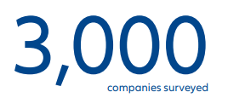


Appendix: Methodology
First survey:
Top 10 represented sectors
Second survey:
Top 10 represented sectors
Number of companies in the total sample (%)
Number of companies in the total sample (%)
1. Retail (19%)
2. Manufacturing (15%)
3. IT, technology and telecoms (10%)
4. Construction (7%)
5. Logistics and supply chain (6%)
6. Healthcare (6%)
7. Automotive (5%)
8. Machinery and equipment (4%)
9. Real estate and property (4%)
10. Chemicals (3%)
1. Manufacturing (25%)
2. Retail (16%)
3. IT, technology and telecoms (13%)
4. Automotive (12%)
5. Real estate and property (6%)
6. Logistics and supply chain (6%)
7. Machinery and equipment (6%)
8. Construction (4%)
9. Agriculture and food (2%)
10. Energy and Utilities (2%)
Companies’ size
Turnover
Number of employees

